Slide 1
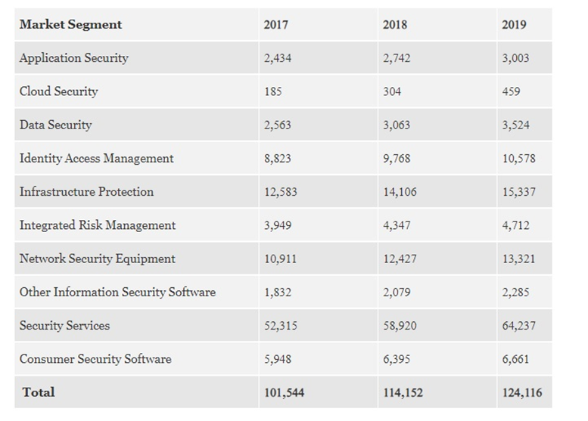
(Gartner, 2018, millió USD-ben)

Slide 2
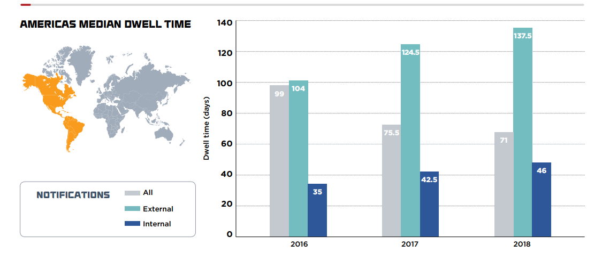
Fire Eye MTrends 2018 vs. 2017

Slide 3
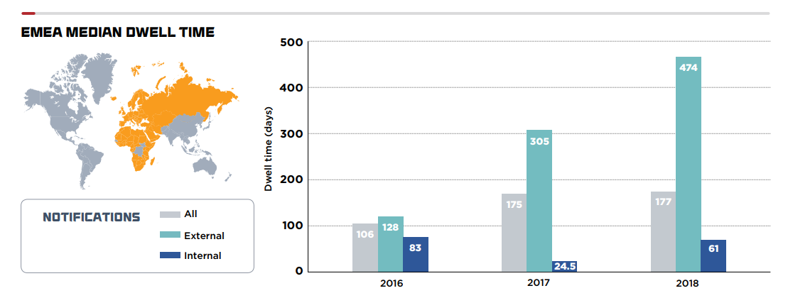
Fire Eye MTrends 2018 vs. 2017

Slide 4
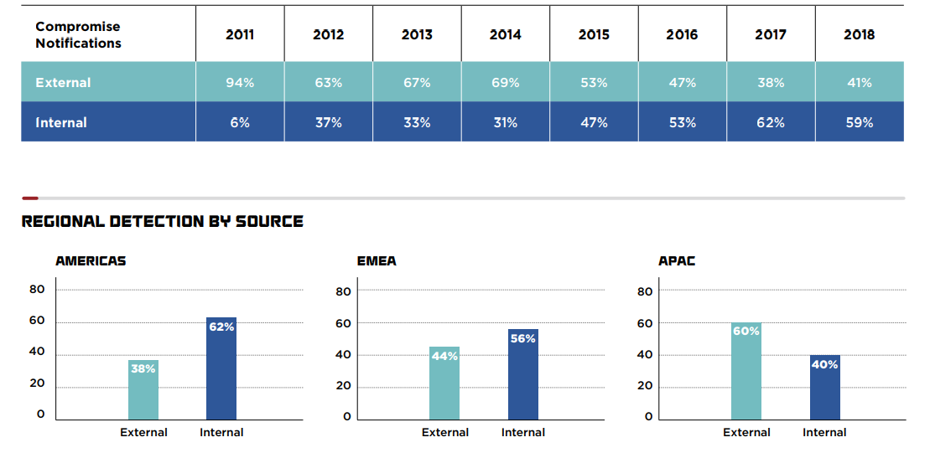

Slide 5
A költséges preventív renszerek ellenére a támadások hónapokig felfedezetlenek
Preventív védekezés
Aktív támadás
Elhárítás és javítás
EMEA átlag detekció 175 nap
€ € € €
Végpontvédelem
Tűzfal
IPS
Proxy
Sandbox
Webszűrő
Email biztonság
Biztonsági rés
€ €
Saját SOC
Kiszervezett SOC
Incident response konzultáció
Elavult detekciós technológiák
Naplóelemzés (SIEM)
Forensic vizsgálat
Támadás rekonstrukció
Forrás: FireEye M-Trends

Slide 6
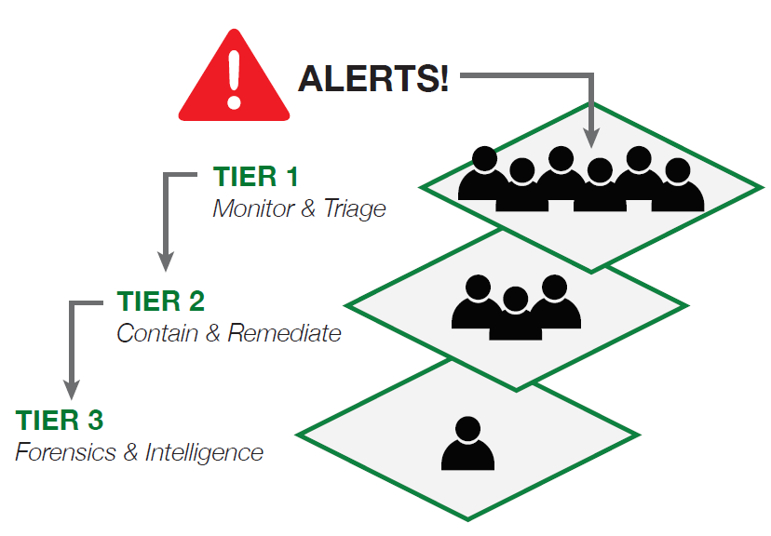
SOC [Security Operations Center] szintek
Problémák
Zajos detekció
Sok téves riasztás
Aránytalanul sok emberi munka
“Alert fatigue”
és figyelmetlenség

Slide 7

Miért csak idő kérdése a sikeres kibertámadás ?
Támadás
Mindig lépéselőnyben
Automatizált exploitok
Egyetlen sikeres támadás
kell csak a bejutáshoz
Védekezés
24x7 figyelem
Munkaigényes támadáskeresés
Könnyű és elkerülhetetlen
legalább egyszer hibázni

Slide 8

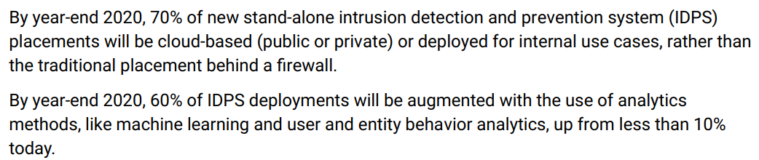
A belső hálózati behatolás-detekció (IDS) a jövő
Forrás: Gartner IDPS, 10 January 2018

Slide 9
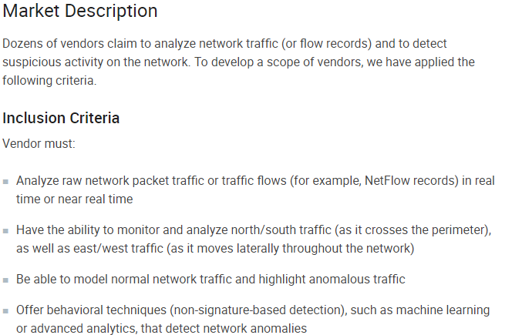
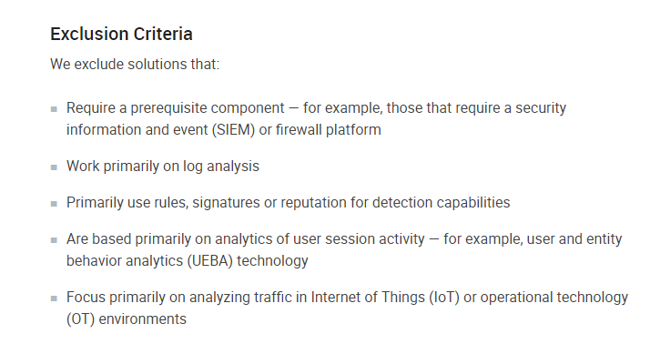
Forrás: Gartner NTA, 2019 február
https://www.vectra.ai/download/gartner-market-guide-for-nta-2019#form-download

Slide 10
Cognito Detect – fókuszban a viselkedés modellek
Kiberbiztosági kutatás
Adattudomány
Alapvető támadási metódusok azonosítása
Gépi tanulás alapú modellek
10 megkapott szabadalom
20+ szabadalom folyamatban
Támadási viselkedés modellek
Nagy pontosságú, szignatúra mentes detekció
Command and Control
Fejlett C2: emberi irányítás
Botnet C2
Felderítés
Szkennelés és felderítés
AD, RPC, fájlmegosztás, stb.
Belső mozgás
Ellopott jogosultságok
Exploitok
Hátsókapuk
Adatlopás
Adatmozgások
Rejtett adatlopás, pl.: tunnelek
Notes:
Lots of vendors throw around the terms ML and AI, so let’s dig into what we’re doing, how it’s different, and why that matters.
Every other product in this space treats detection purely as a data science problem. Take attributes of the network like connection counts or data volumes, baseline them, and then flag anything “different”. An anomaly. The idea is that attackers will behave differently, so the anomalies will find them. There are two problems that cause this to fail in practice:
There’s a LOT of different in enterprise networks. The approach ends up creating a large stack of needles, then asking the analysts to find the needle in the needlestack. [optional elucidation] If you observed a user for 30 days, how likely is it that you can predict what they will do on the 31st day? Let's be generous and say the likelihood is 95%. So, for every 10,000 users, you will have 500 acting strange on a given day. [Insert a personal example about something that caused you to do something very different – travel, a holiday, some research you were doing, whatever].
Worse, in order to try to deal with the noise problem, models are often tuned to look only for distant outliers. This gives a stealthy attacker plenty of space to operate while staying under the radar. So the attacker isn’t even in the needlestack. Meaning lots of extra work for nothing.
Vectra’s approach is fundamentally different. We are building a SECURITY product, so we start with SECURITY research. Rather than analyzing specific malware or tools in order to generate signatures, though, our researchers identify the fundamental methods that attackers MUST use to successfully execute their attacks. Think of this approach as looking for TTPs (Tools, Techniques, Procedures) with the first "T" removed. The first T - “Tools” detection - is classic signature based technologies. The techniques – methods - remain constant even as tooling changes. Methods are the most difficult and expensive for attackers to change.
THEN we bring in the data scientists and partner them with the security researchers. They choose whatever ML techniques are best to find the targeted behavior without signatures: supervised learning, unsupervised learning, deep learning, heuristics – often multiple techniques in the same model. We call these attacker behavior models.
By zeroing in on the specific useful attacker behaviors, we can detect even stealthy activity with accuracy.
[CLICK] to build out the categories
These attacker behaviors span the kill chain, everything that an attacker must do post-compromise.
Controlling the system from outside with some sort of hidden tunnel or RAT. We’re looking at how the control connection is being used, so it doesn’t matter what the specific tool is or whether the traffic is encrypted or not.
Learning about the network that they dropped into blind. This includes both network scans and sweeps, as well as more advanced techniques like AD recon to learn about admin groups and credential privileges. Or mounting file shares to try to find credentials buried in scripts or to find where the data lives.
Moving laterally whether through stolen accounts, exploits, or by triggering backdoors previously installed on a compromised system. For every host in the network, we map which credentials it uses to access which services; which other hosts it administers via which protocols; how it uses RPC for remote code execution; how it uses RDP. So when a stolen credential is used to try to move laterally, it’s going to trigger one or more of these models.
While we focus much more heavily on the early stages of the attack, we do also detect data exfiltration. This is both by looking at how data is gathered, staged, and moved out of the network. As well as methods like tunneling. We’re not looking at payloads like DLP which only finds accidental leakage – our approaches work independent of encryption, chunking or other obfuscation techniques, and independent of the protocol used.

Slide 11
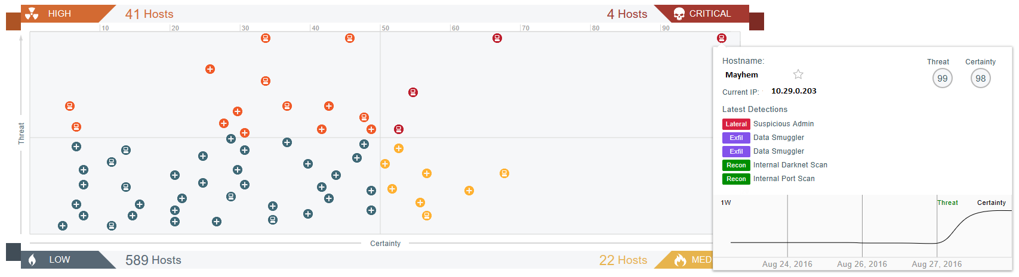
Cognito fontossági sorrendbe teszi a hosztokat…

Slide 12
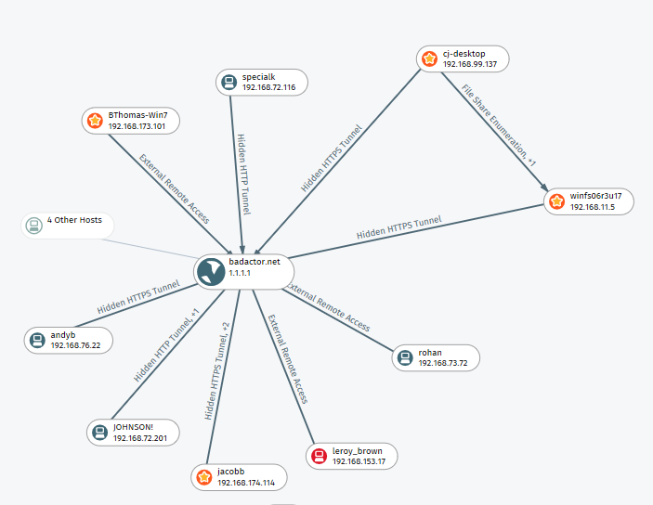
…és felderíti a teljes támadást, minden érintett géppel…

Slide 13
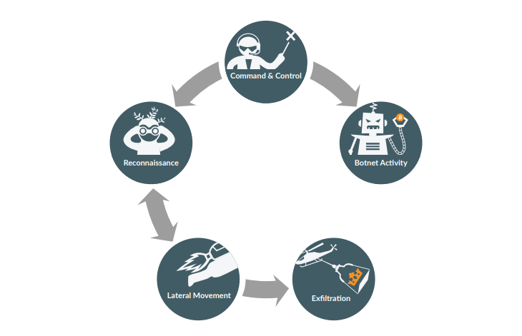
A Vectra „Kill Chain”

Slide 14
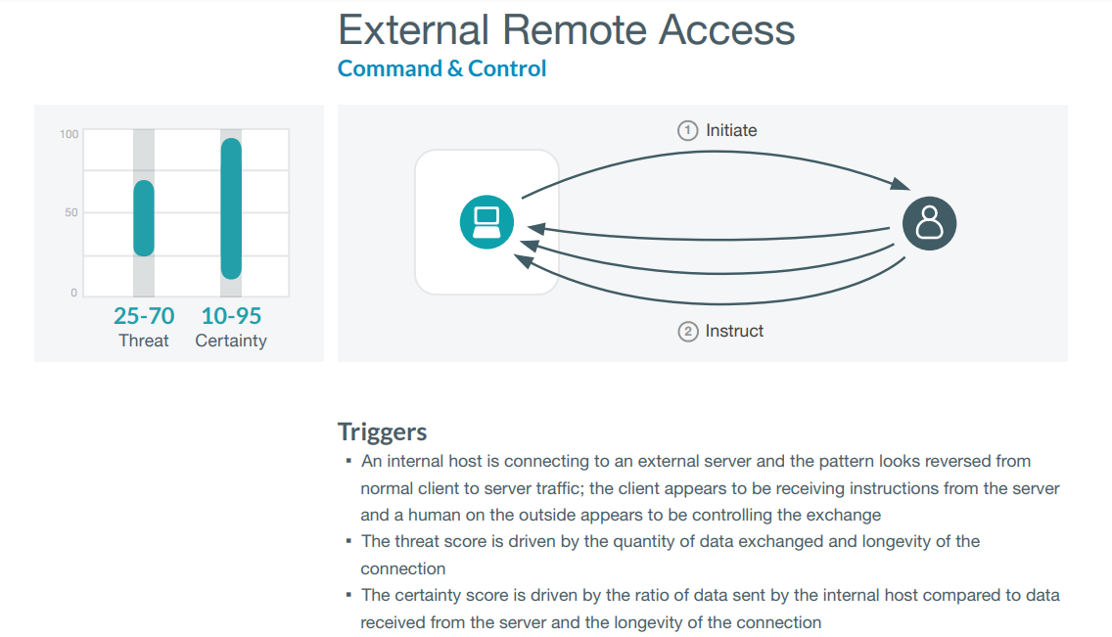
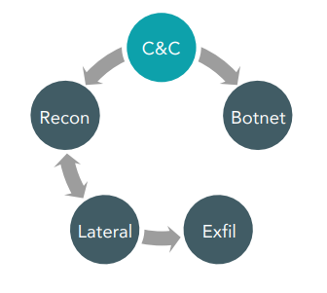

Slide 15
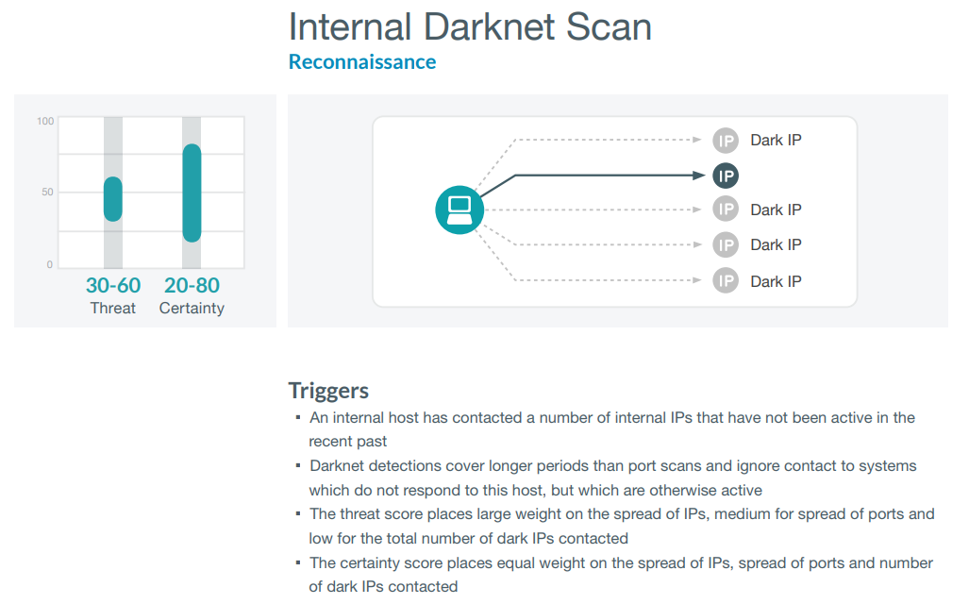
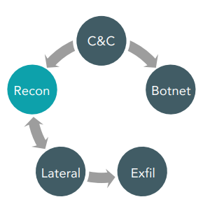

Slide 16
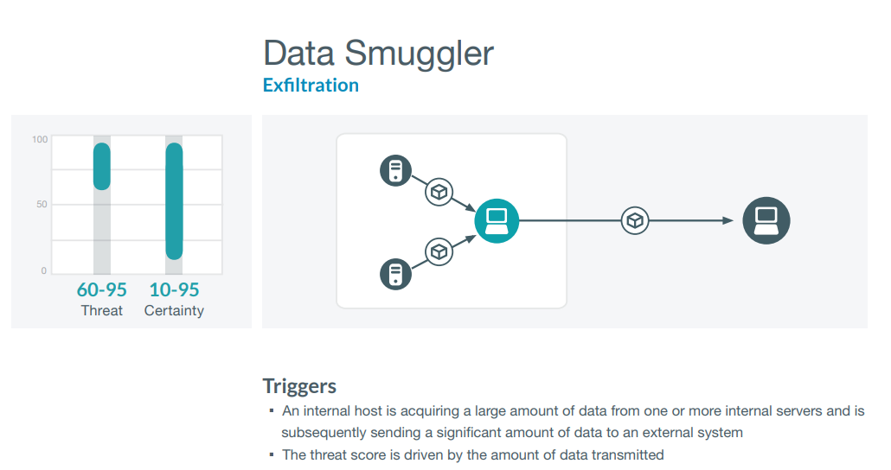
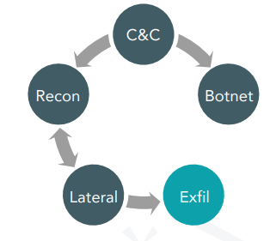

Slide 17
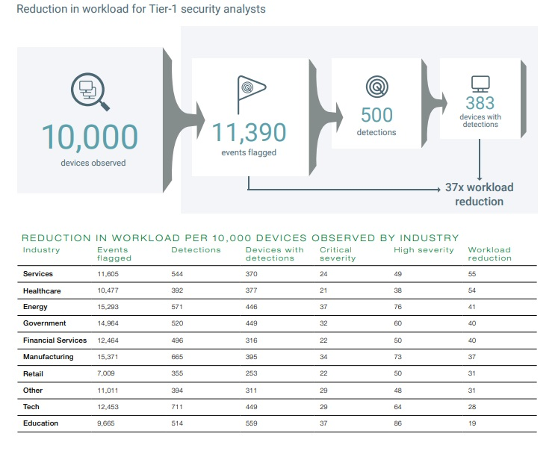
https://www.vectra.ai/download/attacker-behavior-industry-report-2019-rsa-conference-edition#form-download
(374 ügyfél, 3 millió végpont, 10,000 eszközre és egy hónapra normalizálva, 2018)

