Slide 1

filter:max PAMBurger Party
Get your Company SECRETS Secured..
presented by Wolfgang Wimmer, Channels Sales Manager Thycotic EE

Slide 2
The problem:
Login´s, Account´s, Password´s
  Every standard Employee today has to remember at least 15 Logins
  Today´s IT Admin´s have to work with hundred´s or thousand´s of Accounts and Login credentials on-premise & cloud.
  This “Secrets” represent one of the most vulnerable aspects of an organization’s IT infrastructure.
  “Secrets” are very often stored in plain text in Text, Word or Excel files.
Notes:
So lets turn to our PAM solutions… And to do this, lets start by making sure we are aligned around the definition of a privileged account.
Privileged accounts are high-access, non-human accounts (such as Domain Admin or root) used by IT admins, developers, services and applications which often provide unfettered access to data, infrastructure and systems
Privileged accounts exist in nearly every connected device, server, virtualization platform, operating system, database and application throughout on-premises and cloud-based datacenters
Additionally, privileged accounts extend beyond your organization’s traditional IT infrastructure to include social media accounts, which can be misused to cause significant reputational damage and other harm to an enterprise.
With the increasing complexity of IT infrastructures, the number of privileged accounts has grown exponentially - . In fact, Organizations typically have two to three times more privileged accounts than employees
Privileged accounts consistently remain one of the most vulnerable and and most heavily targeted assets in your IT infrastructure by hackers, rogue employees and malicious software

Slide 3

32
%
OF HACKERS SAY
accessing privileged accounts was the number one choice for the easiest and fastest way to get at sensitive data

Slide 4
Privileged Accounts
What is a privileged account?
  Non-human accounts used by IT staff which often have unfettered access to critical data and systems i.e. Domain Admin, root.
  Exist everywhere in nearly every connected device, server, hypervisor, OS, DB, or application: on-premises & cloud.
  Represent one of the most vulnerable aspects of an organization’s IT infrastructure.
Notes:
So lets turn to our PAM solutions… And to do this, lets start by making sure we are aligned around the definition of a privileged account.
Privileged accounts are high-access, non-human accounts (such as Domain Admin or root) used by IT admins, developers, services and applications which often provide unfettered access to data, infrastructure and systems
Privileged accounts exist in nearly every connected device, server, virtualization platform, operating system, database and application throughout on-premises and cloud-based datacenters
Additionally, privileged accounts extend beyond your organization’s traditional IT infrastructure to include social media accounts, which can be misused to cause significant reputational damage and other harm to an enterprise.
With the increasing complexity of IT infrastructures, the number of privileged accounts has grown exponentially - . In fact, Organizations typically have two to three times more privileged accounts than employees
Privileged accounts consistently remain one of the most vulnerable and and most heavily targeted assets in your IT infrastructure by hackers, rogue employees and malicious software

Slide 5

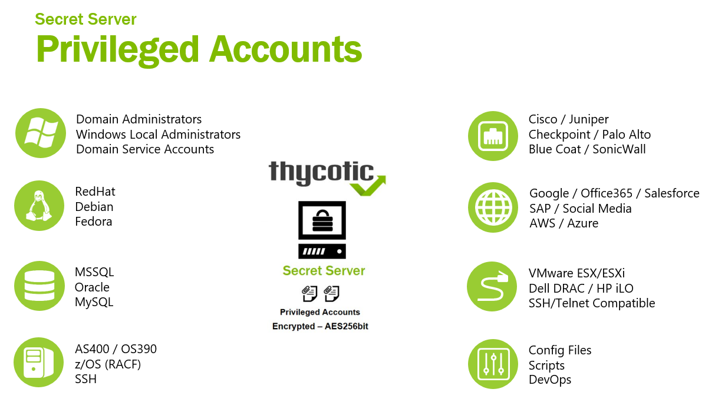

Slide 6

Accounts and Password´s usage today..
Zsolt, 22 Years old, IT Administator
responsible for 80 Servers and 260 Workstations
Can´t remember Passwords longer than 10 chars
Is responsible for 500 Service Accounts within the organisation (Windows, Unix, IBM, Cloud)
Uses usually same Passwords on all accounts he needs to manage
Stores them in a secret location in a plain text document
Changes usually every 2 Years Companies
Marcin also manages this cloud services and required Admin accounts:
Azure
Egnyte
Office365
Google
Evernote
Adobe
Salesforce
Amazon AWS
PhoenixNAP
Dropbox

Slide 7
ROI and Time Saving
Zsolt´s company implemented Thycotic PAM and now he can
Manage all privileged accounts in one interface
Discover all unknown privileged accounts
Setup secure encrypted vault, permissions, users and structure
Store and Rotate sensitive acounts within Secret Server
Implement RBAC, Access Requests, and other controls
He can now work with:
  Session launching
  Session proxying
  Session monitoring
  Session recording
Implement least Privilege Access accross his organisation without
spending much time on administrative tasks

Slide 8
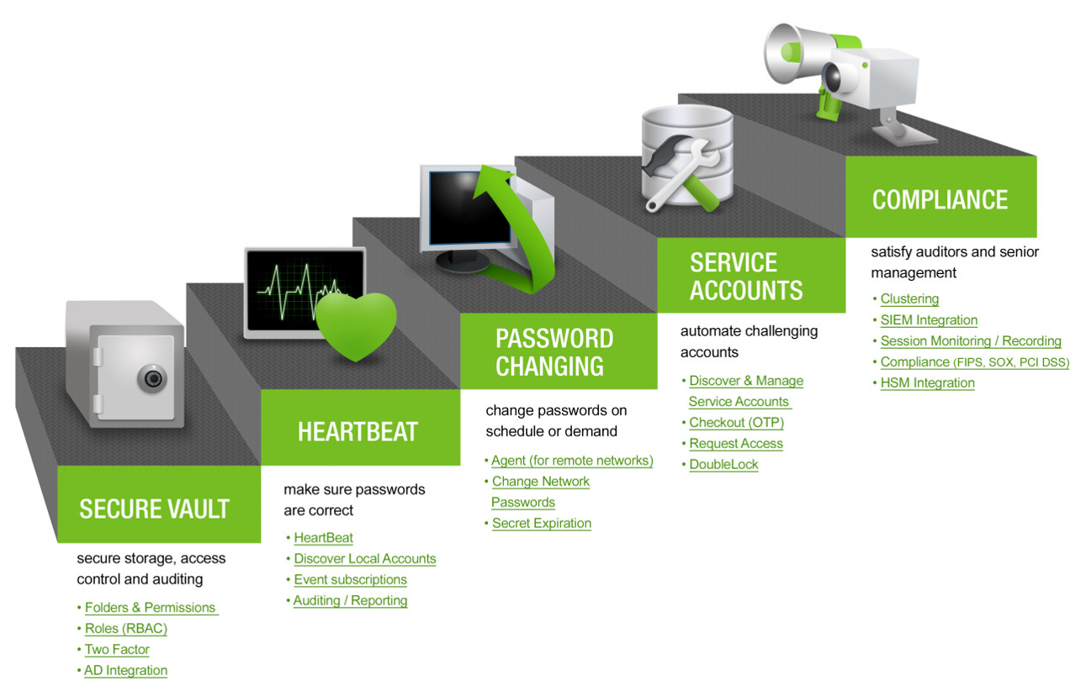
Get your privileged accounts report in 1 DAY!
Get All your company Secrets Secured in 1 week!

Slide 9
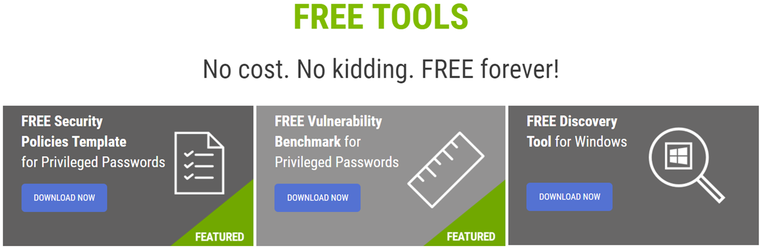

Slide 10
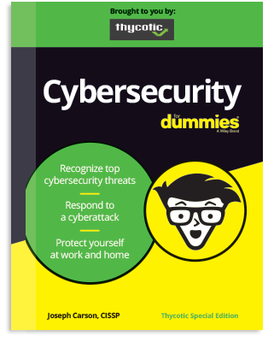
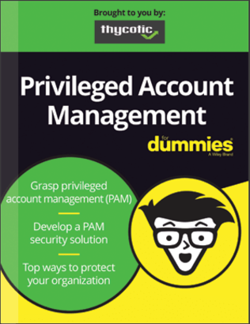
Free Resources

Slide 11
Free tool or:
Login´s, Account´s, Password´s
  Every standard Employee today has to remember at least 15 Logins
  Today´s IT Admin´s have to work with hundred´s or thousand´s of Accounts and Login credentials on-premise & cloud.
  This “Secrets” represent one of the most vulnerable aspects of an organization’s IT infrastructure.
  “Secrets” are very often stored in plain text in Text, Word or Excel files.
Notes:
So lets turn to our PAM solutions… And to do this, lets start by making sure we are aligned around the definition of a privileged account.
Privileged accounts are high-access, non-human accounts (such as Domain Admin or root) used by IT admins, developers, services and applications which often provide unfettered access to data, infrastructure and systems
Privileged accounts exist in nearly every connected device, server, virtualization platform, operating system, database and application throughout on-premises and cloud-based datacenters
Additionally, privileged accounts extend beyond your organization’s traditional IT infrastructure to include social media accounts, which can be misused to cause significant reputational damage and other harm to an enterprise.
With the increasing complexity of IT infrastructures, the number of privileged accounts has grown exponentially - . In fact, Organizations typically have two to three times more privileged accounts than employees
Privileged accounts consistently remain one of the most vulnerable and and most heavily targeted assets in your IT infrastructure by hackers, rogue employees and malicious software

Slide 12


“Through 2021, organizations with (PAM) tools will have at least 50% lower risk of impact by advanced threats as compared to their peers without PAM tools”.
- Gartner PAM Best Practice Report 2017
PAM is the global need to secure IT
“Through 2020, more than half of the security failures associated with IaaS and PaaS will be attributable to security gaps caused by failure to adopt PAM technology and processes”
. – Gartner Investment Report 2017
80 %
of breaches involve privileged credentials
Forrester Wave
Notes:
Let me read you the headline of an article written this September:
“Nation-sponsored hackers have penetrated the operational networks of multiple US and European energy companies used to control key parts of the power grid that supplies electricity to hundreds of millions of people”
-https://arstechnica.com/information-technology/2017/09/hackers-lie-in-wait-after-penetrating-us-and-europe-power-grid-networks/

Slide 13






Secret Server
Quickly discover, control, manage, & protect privileged accounts
ESTABLISH VAULT
RUN
DISCOVERY
PROTECT SECRETS
DELEGATE ACCESS
CONTROL SESSIONS
Setup secure encrypted vault, permissions, users, and structure
Discover all of your unknown privileged accounts
Store and Rotate your sensitive accounts within Secret Server
Implement RBAC, Access Requests, and other controls
Add session launching, proxies, monitoring, and recording

Slide 14

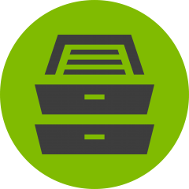



Privilege Manager
Ease the burden of removing administrative credentials.
REMOVE ACCOUNTS
DEPLOY
AGENTS
ADD
CONTROLS
APPLY
POLICY
ADJUST PRIVILEGE
Use Secret Server to remove administrative accounts
Deploy agents to discover and inventory endpoint app and processes
Create simple app whitelisting & control policies
Add system rights policies – allowing standard users to add printers
Implement privilege elevation / reduction for apps

Slide 15
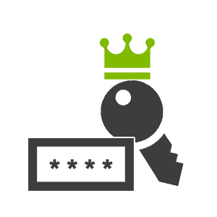


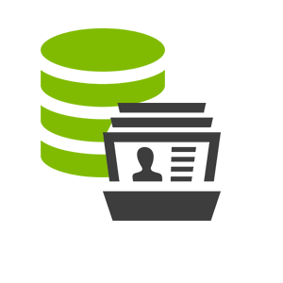
Key Use Case – GDPR - RODO - Data protection principles:
MUST protect privileged accounts
EU Citizens
Personal Data (PII)
Privileged Accounts
Privileged Account
Management

Slide 16
GDPR Data protection principles
protecting privileged accounts
Covering Art. 5 (1) f - Art. 25 or Recital 76
(a) Fairly and lawfully processed – RECORD AND MONITOR SESSIONS
(b) Obtained only for specified purposes - RECORD AND MONITOR SESSIONS
(c) Adequate, relevant & not excessive – DISCOVER, AUDIT AND MONITOR
(d) Accurate and up-to-date – KEEP PRIVILEGED ACCOUNTS UP-TO-DATE
(e) Not kept for longer than necessary – EXPIRE PRIVILEGED ACCOUNTS
(f) Kept Secure – PROTECT AND SECURE PRIVILEGED ACCOUNTS
(2. )Accountability - AUDIT AND MONITOR
**Enforce Least Privilege across Admin and User Accounts**

Slide 17










































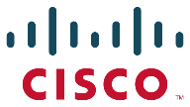






























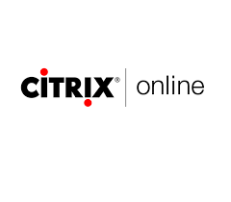










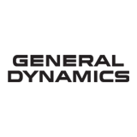







Protected Customers Worldwide

Slide 18

Central Europe Customers

