Slide 1


I am your greatest asset
I am your greatest risk
How can CASB help your digital transformation?
Filter:max
Budapest
11 April 2019
Dave Barnett
David.Barnett@forcepoint.com
+447880176585
Add Classification Label: Forcepoint Private | Forcepoint Proprietary | Public

Slide 2


Slide 3
We want to help you overcome your compliance barriers to accelerate a cloud first culture.
Notes:
Super simple and focused –only product can accelerate 3rd party product
start with why - our secret weapon is simplicity – execution is everything

Slide 4
How can a CASB accelerate my digital transformation?
Our CASB can reduce the data and human behavioral risk of using cloud….so that you can use more cloud.
Forcepoint and Filter:max make it simple

Slide 5


Why Protect Data in Cloud?
43%
of all corporate data is stored in the cloud
Types of
Data at Risk
Payment information
Customer information
Consumer data
Email
Employee records
of this data is not managed or controlled by IT
53%
Notes:
https://www.i-scoop.eu/cloud-data-security-cloud-data-protection-measures/
http://www2.gemalto.com/cloud-security-research/
77% of enterprises have at least one application or a portion of their enterprise computing infrastructure in the cloud
https://www.prnewswire.com/news-releases/85-of-enterprises-keeping-sensitive-data-in-the-cloud-70-very-or-extremely-concerned-about-it-according-to-2016-vormetric-data-threat-report--cloud-big-data-and-iot-edition-300225175.html
Cloud computing spending has been growing at 4.5 times the rate of IT spending since 2009
https://www.forbes.com/sites/louiscolumbus/2017/04/29/roundup-of-cloud-computing-forecasts-2017/#4e93769931e8

Slide 6

Gartner: CASB is a catalyst for digital transformation
10%
CURRENT CASB MARKET PENETRATION IN the EU
65%
OF EU ENTERPRISES EXPECTED TO HAVE A CASB BY END OF 2020
“CASB will be a $1Bn market by 2019 and will be to cloud as firewalls are to data centers by 2020”
Neil McDonald – Gartner 2018

Slide 7
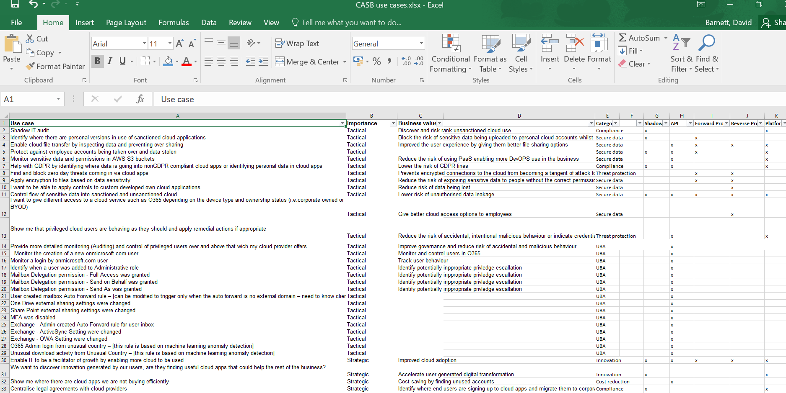
CASB Hype vs Hope
“I assume
CASB can
do X,Y,Z?”
“Everyone
will need
a CASB”
HOPE
HYPE
Value
Proven use cases

Slide 8



What concerns slow digital transformation?
Users oversharing data in file sharing and collaboration apps
Admins making mistakes or becoming under attack
The cloud is the the new attack surface and a lack of governance
Employees and 3rd parties accessing cloud apps from their own devices
Concerns about employees finding and using their own cloud services aka shadow IT
Notes:
Shadow IT – could be bad, could be source of innovation if use CASB to control it

Slide 9
Forcepoint cloud protection products
Forcepoint
DLP
Forcepoint
CASB
Forcepoint
Web Security
DLP Cloud Apps
Cloud App Control
Get cloud protection based on your needs.
Notes:
Integration with Forcepoint portfolio of cybersecurity solutions provides cloud protection based on your needs

Slide 10



CASB control options - high level
 | Unmanaged Device | Managed Device
Corporate Tenant
Personal Tenant
Control
Visibility
Notes:
As well as managed and unmanaged devices, customers need to consider managed and unmanaged services – such as personal and corporate O365

Slide 11
CASB control options – low level
 | Unmanaged Device |  | Managed Device
Corporate Tenant |  | API |  | API
 |  | Agents |  | Agents
 |  | Forward Proxy |  | Forward Proxy
 |  | Reverse Proxy |  | Reverse Proxy
Personal Tenant |  | API |  | API
 |  | Agents |  | Agents
 |  | Forward Proxy |  | Forward Proxy
 |  | Reverse Proxy |  | Reverse Proxy
Control
Visibility
Notes:
Forcepoint CASB has 4 key integration methods: API, Agents, Forward Proxy & Reverse Proxy (best when also leveraging SSO integrations)
You can mix & match these methods however you like for any given asset, however it is important to understand that some methods may not be available for a given scenario
For example:
API integrations are great for corporate assets, however you won’t get your users to configure their personal systems to send all their logs to your corporate CASB service!
In the same way, good luck getting users to install agents onto personal / unmanaged devices – especially if those users are bad actors!
Agents however are a great tool for corp devices and give additional controls for personal cloud assets – e.g. allow corp O365 and block personal O365, block personal dropbox while allowing the corp account, and so on.
It is a similar story for Forward Proxy, which is a great integration method, but realistically only viable on corporate devices
Finally, Reverse Proxy integrated with SSO is a fantastic way to control unmanaged devices accessing corporate assets. You won’t get users giving you control over their private systems however.
This is all pretty straightforward, yes? :)
Use this grid to:
Identify the most appropriate protections for specific CASB use cases
Shine light on the “creative markitecture” some of our less-scrupulous competitors use to trick customers and sell against us

Slide 12

























Forward proxy DLP/WEB/CASB architecture
Forcepoint
CASB
GW
CASB
Forward Proxy
Customer
Perimeter
Selected
Cloud App
Traffic
Logs
DLP Security manager
Forcepoint
On-premise
DLP components
Forcepoint
Web gateway

Slide 13


Slide 14


Slide 16










Policy extension via DLP Cloud Apps
Need to control data in rest, in motion, and in use across extended enterprise
DLP Cloud Apps
Forcepoint DLP
Discover Data
Control Data
Manage Policies
Ensure Compliance
Major Apps
Managed Devices
O365 ● Box ● G-suite ● SFDC
CASB
All Apps
All Devices
On-Prem
Network
Endpoint
Sanctioned ● Unsanctioned ● Custom

Slide 17

DLP cloud apps API based architecture
CASB API
API
DLP Cloud
applications
DLP Policies
DLP Incidents
Customer
Perimeter
DLP Security manager
Forcepoint
On-premise
DLP components

Slide 18
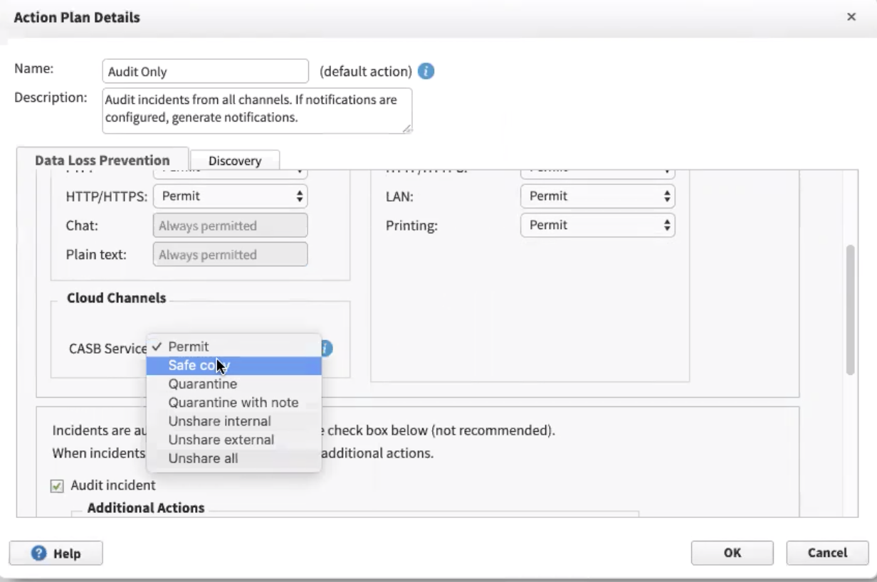
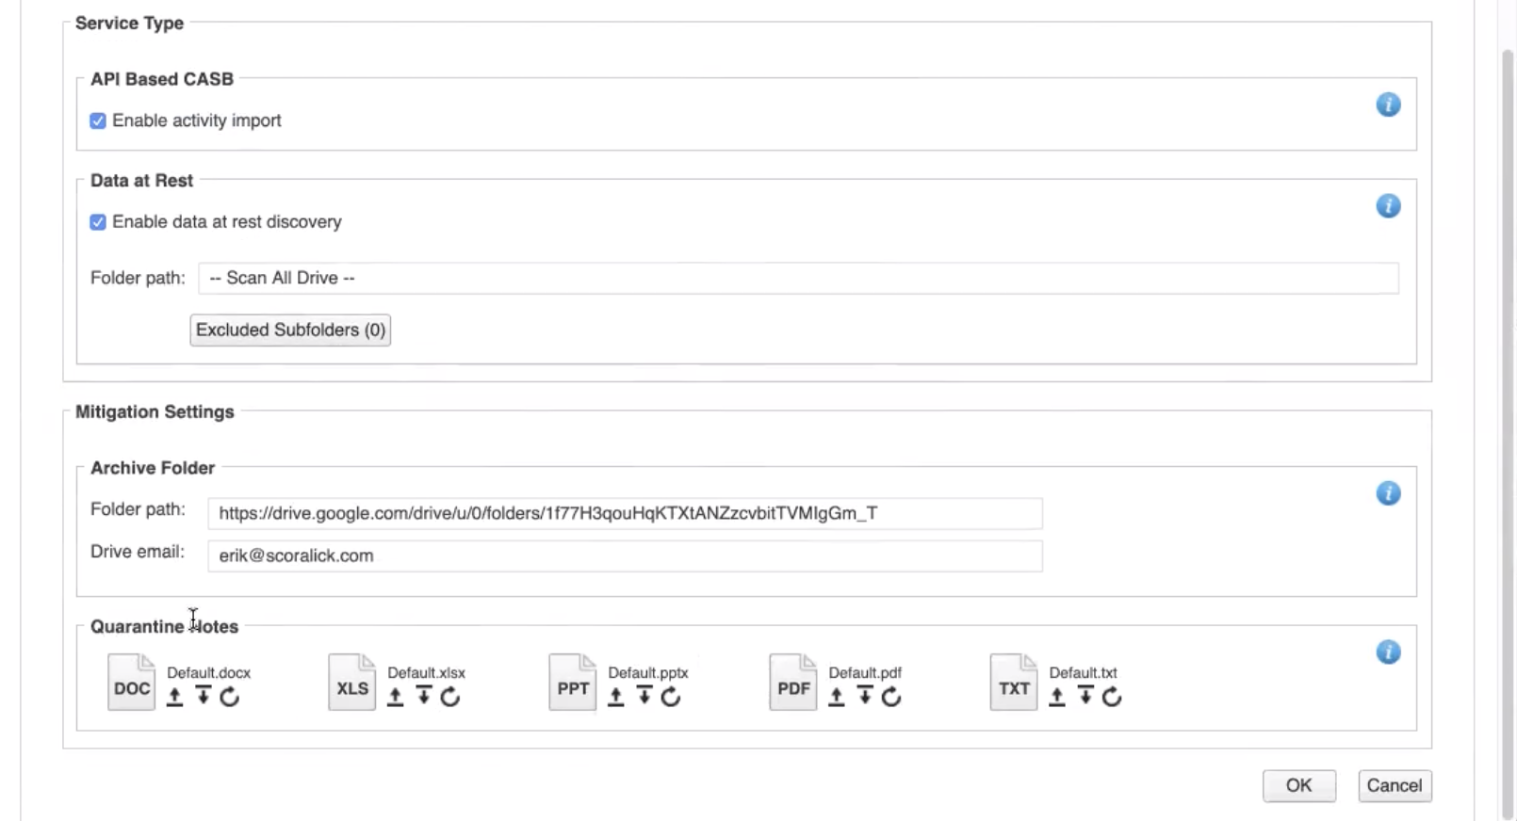
Why is our cloud integrated DLP solution unique?
Desired business outcome:
Forcepoint DLP extending data, discovery into your cloud and driving policy actions
A single pane of glass made simple

Slide 19


Slide 20


Reverse Proxy DLP/CASB architecture
Forcepoint
CASB
DLP Policies
SSO login
GW
Unmanaged/BYOD/Contractors devices
CASB
Reverse Proxy
DLP Incidents
Customer
Perimeter
DLP Security manager
Forcepoint
On-premise
DLP components

Slide 22
Mapping risks to use cases
Oversharing data
Reduce risk of over sharing from OneDrive
Forward proxy controls for any cloud application
Administrator risk
Monitor O365 admins for adding onmicrosoft.com users
Monitor admins who lower the security of AWS
BYOD risk
Enroll contractors devices and apply 3rd party policies
Only give read email and create document permissions to unmanaged devices
Cloud as attack surface
Assess cloud compliance against standards such as Criminal Justice IS/ISO/NIST
Detect hostile nation states attempting to access cloud accounts
Add Classification Label: Forcepoint Private | Forcepoint Proprietary | Public

Slide 23
An integrated DLP/WEB/CASB architecture
CASB API
API
DLP Cloud
applications
Forcepoint
CASB
DLP Policies
SSO login
GW
Unmanaged/BYOD/Contractors devices
CASB
Reverse Proxy
DLP Incidents
CASB
Forward Proxy
Customer
Perimeter
Selected
Cloud App
Traffic
SIEM
Logs
ITSM
DLP Security manager
Forcepoint
On-premise
DLP components
Forcepoint
Web gateway

Slide 24


Slide 25

Combining use cases = actionable intelligence
CASB
User account accessed from an unexpected country
A cloud account is successfully brute forced
A cloud account is accessed from a new device
User account accessed from suspicious IP address range
Notes:
This is why it is essential to be successful for the CASB to be able to to co-ordinate risk around scenareos

Slide 26
Common project deployment
DLP Cloud apps for DAR (GDPR on O365)
Data in motion for O365
Reverse proxy for BYOD/Unmanaged cloud access
Integration with SIEM for CARTA
Data in motion for other cloud apps + real time behavior controls
Cloud compliance module
Phase 1
Phase 2
Phase 3

Slide 27




Forcepoint’s integrated security platform
You need to use Cloud applications they choose they need to be secure and fast
Your reputation depends on good information governance
End users are your best asset but also a significant risk
Security Initiatives
Security Initiatives
Security Initiatives
Secure the adoption of SaaS & cloud
Enable direct-to-cloud connectivity and security for remote offices
Protect off-network users
Modernize your hybrid IT network
Deploy a cloud converged security model from the cloud
Next-gen your data protection
Protect data in the cloud
Discover data in a hybrid environment
Confidently verify regulatory compliance (e.g., GDPR and PCI)
Stop data loss from insiders and compromised users
Prevent sabotage and financial loss
Protecting your supply chain
NGFW
SD-WAN
AMD
Web
CASB
Email
DLP
Behavioral
Analytics
Insider
Threat
Data Guard
Converged Security Capabilities
Forcepoint Proprietary
Notes:
How FP supports customer use cases
Cloud Adoption and Data…
As you can see from what I mentioned about integration across the portfolio
Integration of solutions will be the key to unlocking true value, and this is something which FP have invested heavily in this.
There is overlap between outcomes and initiatives with the technology which mean buy in from different business units within your bank and multiple use cases will improve your risk posture and total cost of ownership

Slide 28
The Forcepoint and Filter:max Advantage
Cloud UEBA
Risk-prioritized alerts
from behavior analytics
in the cloud
BYOD
The most granular device and activity control
Cloud Monitoring
& Control
Fast, comprehensive, and built for any cloud app
Integrated DLP
and CASB
Seamless policy extension from on-premises to
the cloud
Faster
Time-to-Value
Quick and easy onboarding with pre-architected policies under a unified console
Forcepoint helps organizations securely embrace the cloud.
Notes:
<read slides>

Slide 29
Thank you
david.barnett@forcepoint.com

